Slide 1
Information and Communication in an Agile Environment
Master’s Thesis

Slide 2
Who are we?
MSc Software Engineering students from Chalmers and GU

Slide 3
What did we do?
Investigation of agile at scale application with respect to information and communication flow challenges and their effect on productivity determinants related to the empowerment of XFTs

Slide 4
Study Concepts
Communication as a form of humans dynamically exchanging informatino trough various channels
Information as a single manifestation of the contents of a message

Slide 5
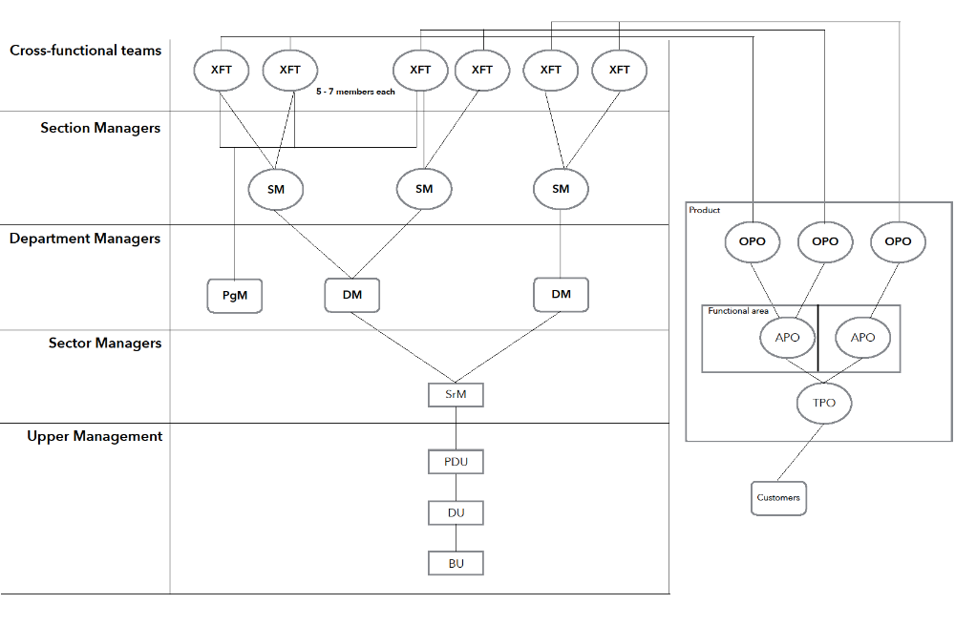
PDU LMR

Slide 6
Research Methods
20 people from 2 XFTs and roles related to them participated in
Surveys (20 people)
Interviews (13 people)

Slide 7
Participants and Their Roles
Role | Survey | Interview | Survey | Interview
 | XFT 1 |  | XFT 2
XFT Scrum Master | 1 | 1 | 1 | 1
XFT Developer | 5 | 2 | 5 | 2
XFT PG | 1 | 0 | 1 | 1
OPO | 1 | 1 | 1 | 1
DM (acting SM) | 1 | 1 | 1 | 1
Program Manager | 1 | 1 | 1 | 1
Total: | 10 | 6 | 10 | 7

Slide 8
Surveys
Daily paper hand-out for 1 week with each XFT
Purpose:
  Investigate communication intensisites according to topics
    Visualise through heatmaps
  Construct social networks

Slide 9
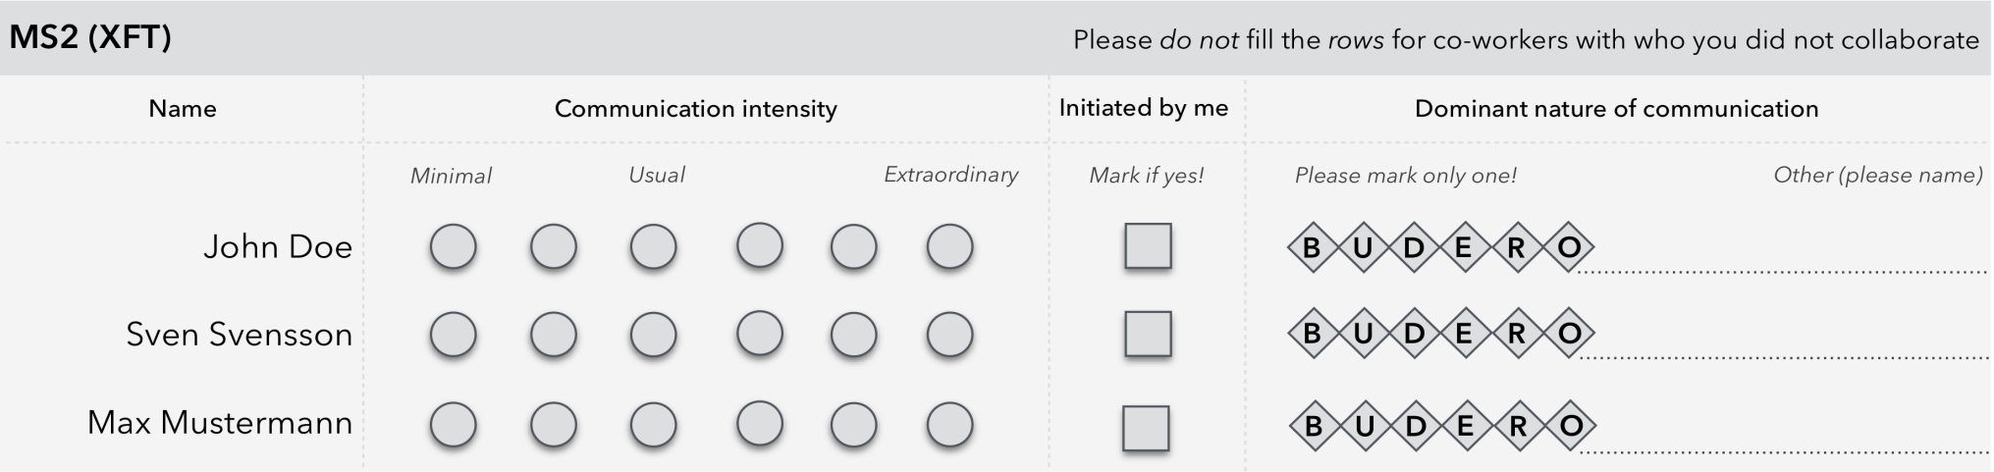
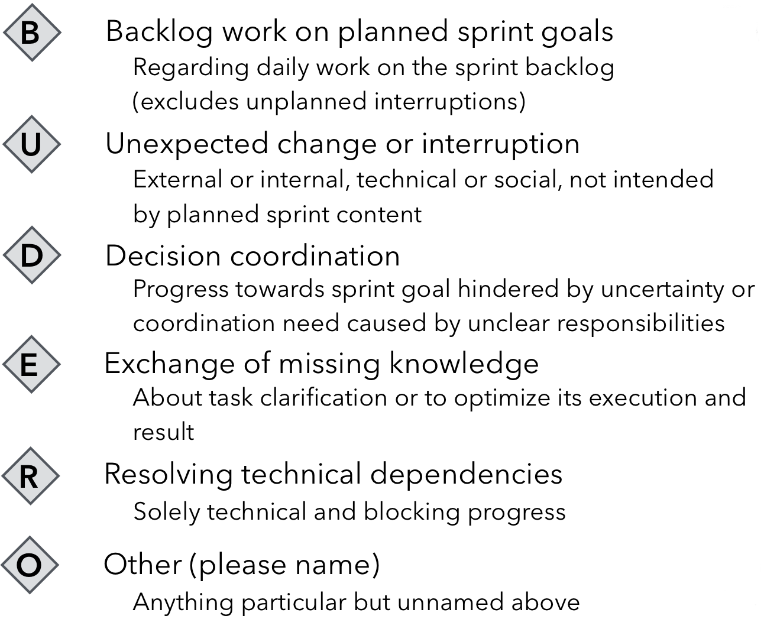

Slide 10
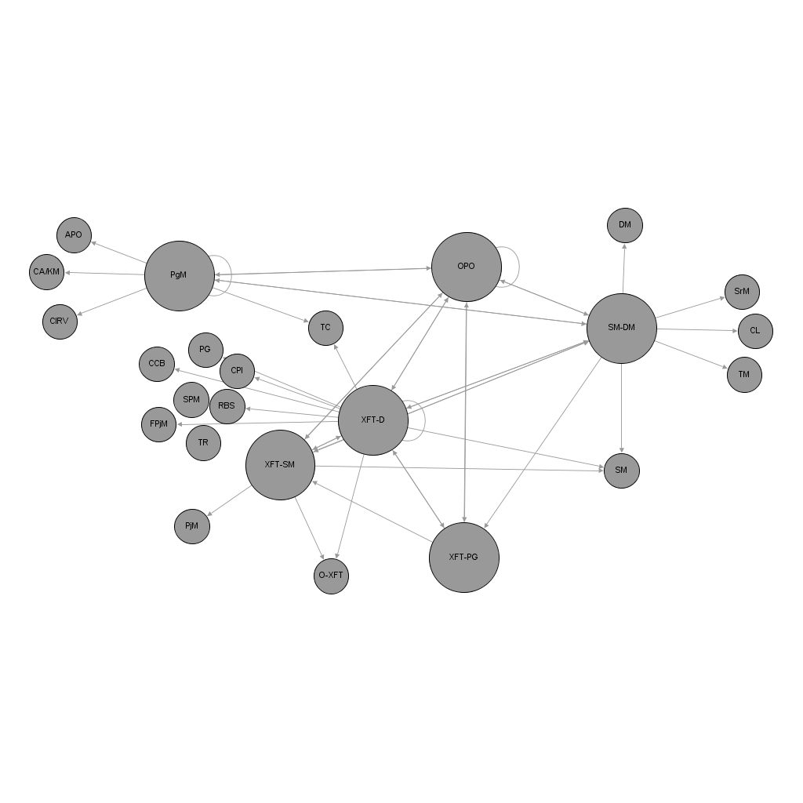
XFT-1: Social Network

Slide 11
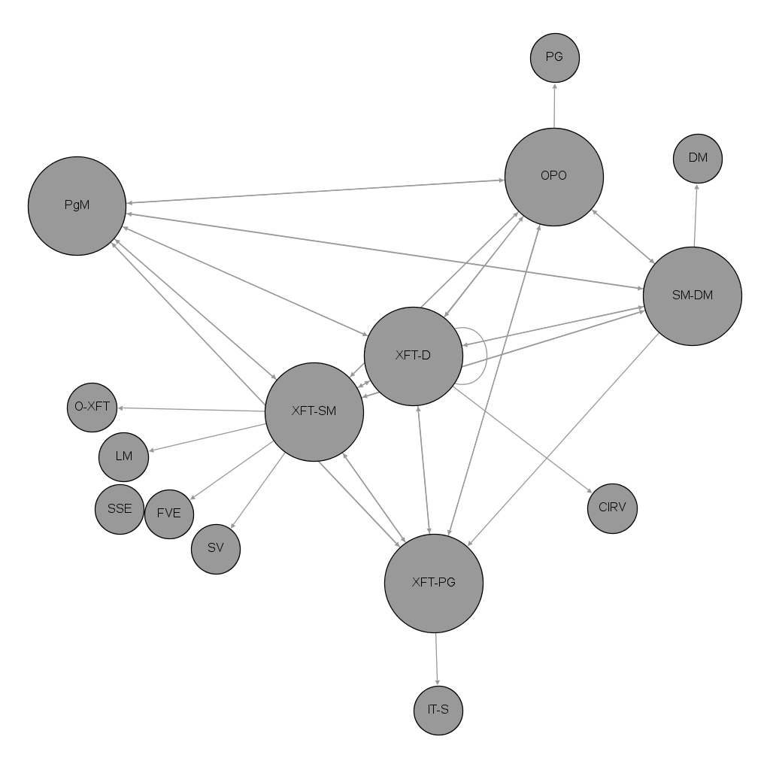
XFT-2: Social Network

Slide 12
Interviews
Semi-structured 30-60 minutes long interviews
Purpose:
  Investigate challenges related to communication and information flow
    Study their influence on the productivity aspects of XFTs

Slide 13
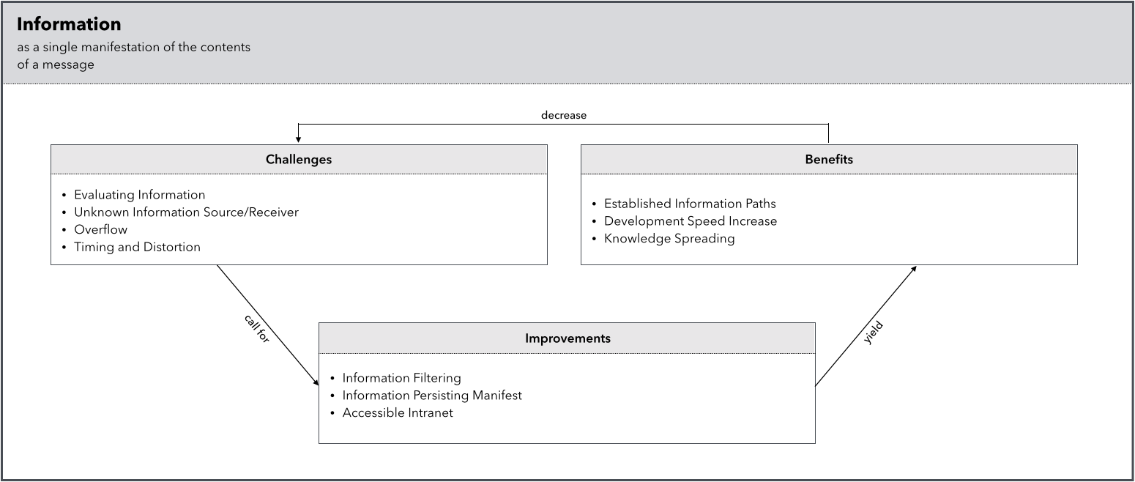
Information

Slide 14
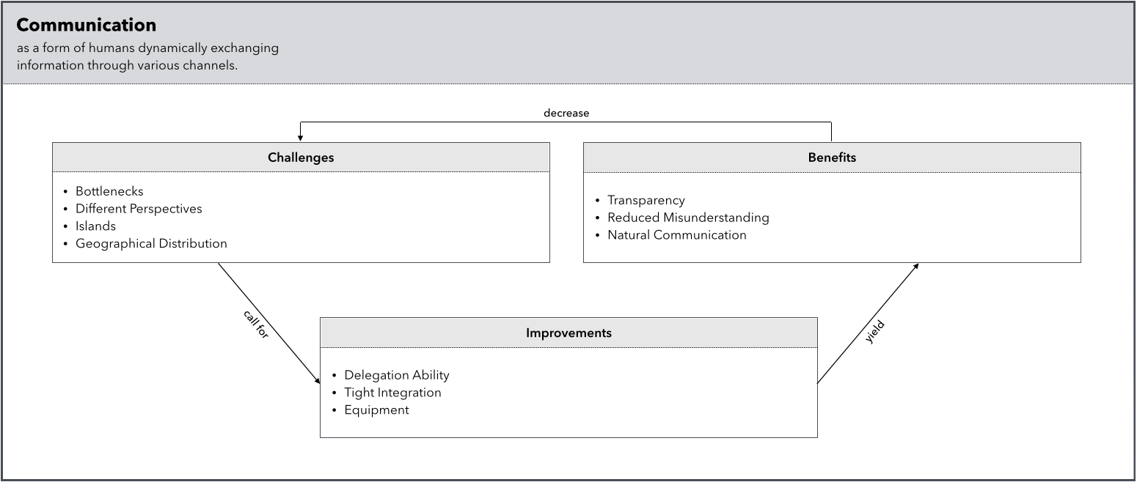
Communication

Slide 15
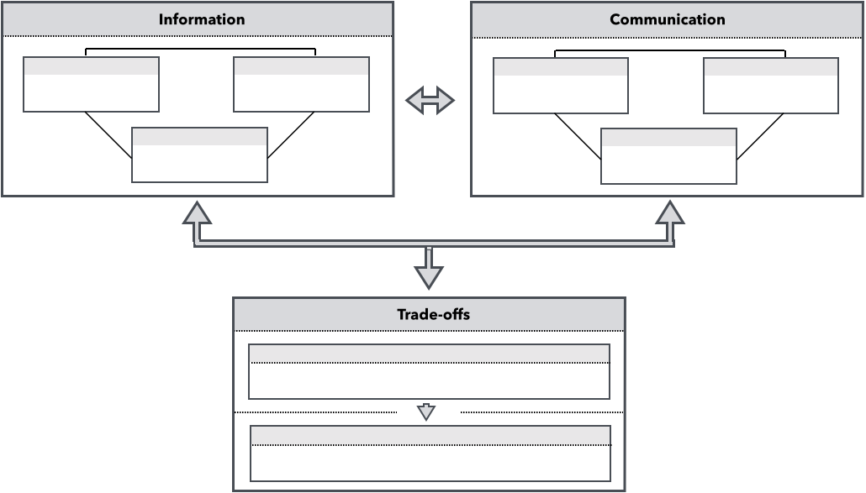
Overview

Slide 16
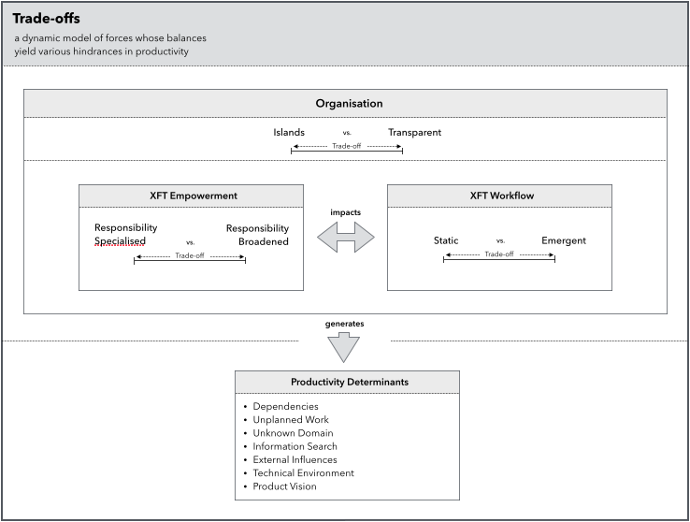
Trade-offs

Slide 17
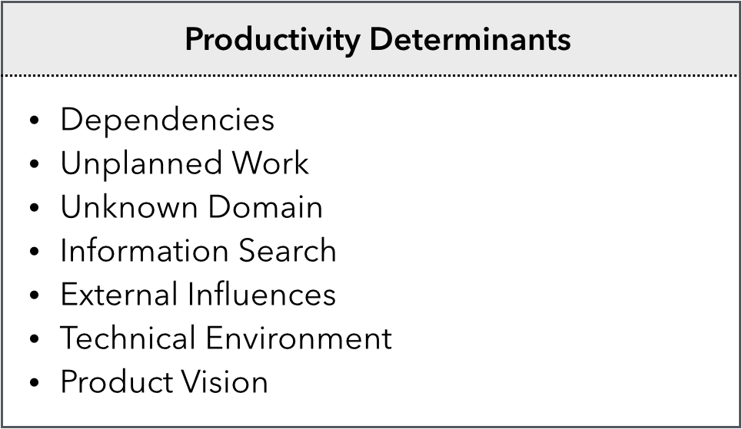

Slide 18
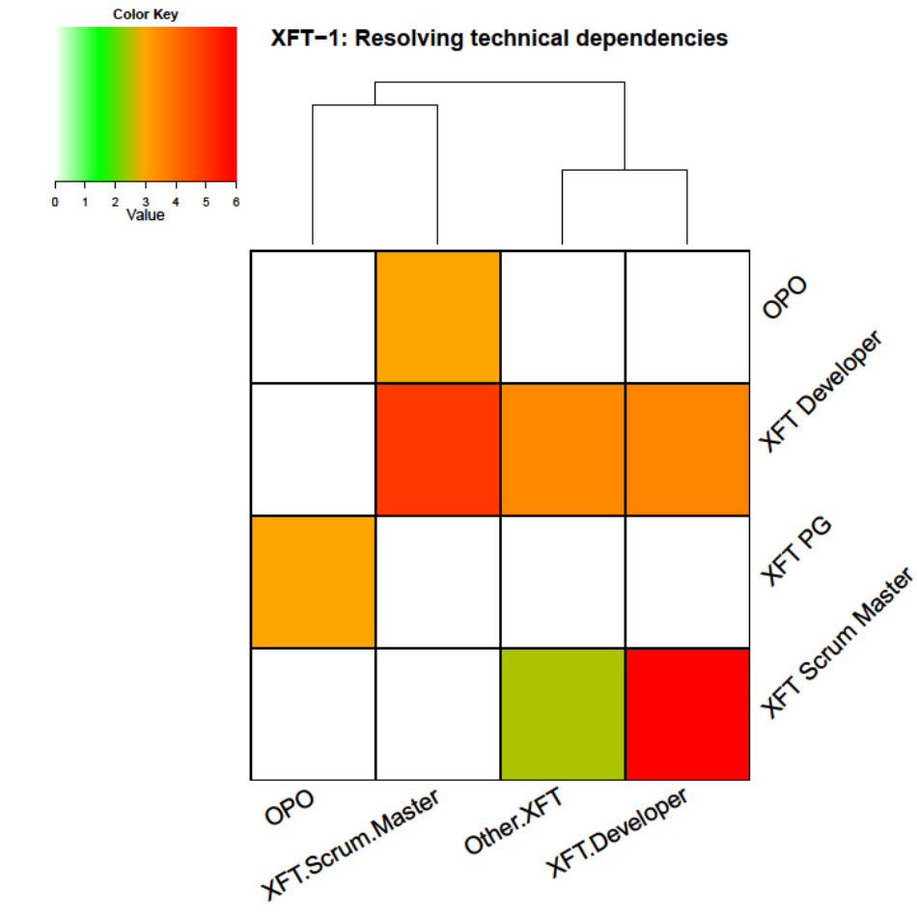
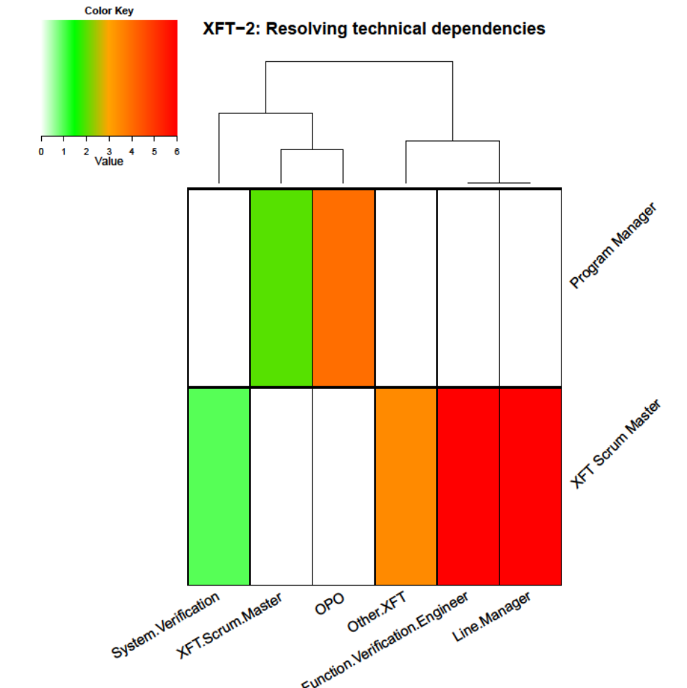
Resolving Technical Dependencies

Slide 20
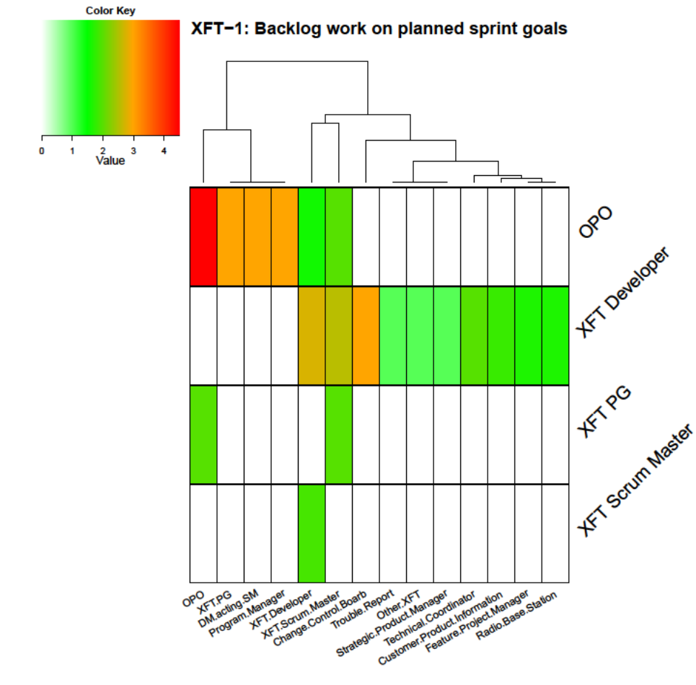
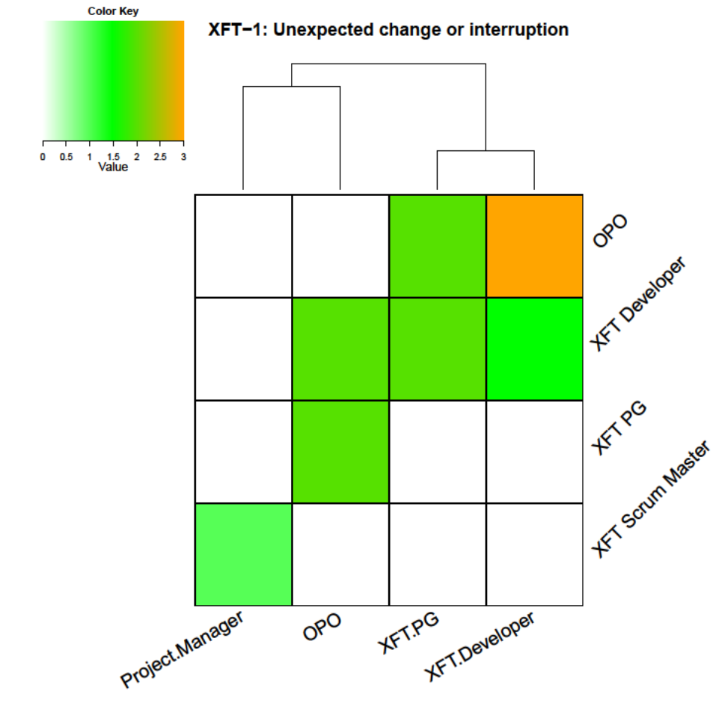
XFT-1: Backlog work vs Unexpected Change

Slide 21
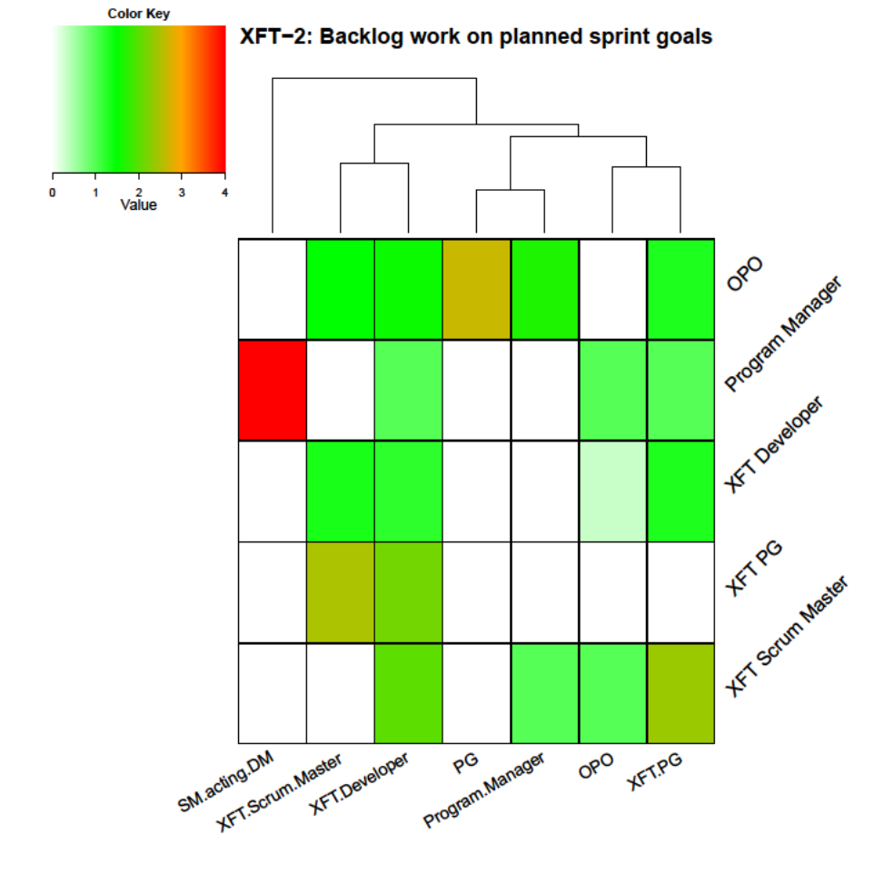
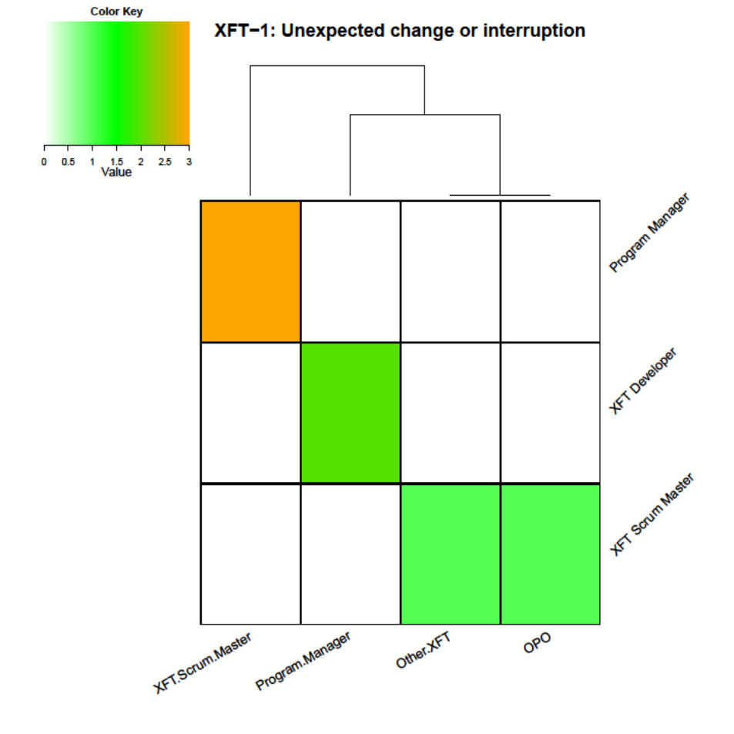
XFT-2: Backlog work vs Unexpected Change

Slide 23
Conclusions
We touched the base, what is next?
More surveys with more XFTs – more profound and diverse findings
Profound study of information and communication challenges
Relation of productivity determinants to different trade-offs positioning

Slide 24
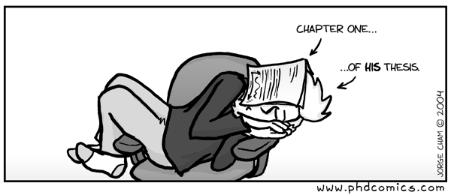
Questions?

